Slide 1
K8C
Resources and microservices
K8S access user: Smolkin Mikhail

Slide 2
Product description
The product is a platform for deploying, managing, and scaling machine learning models in production. It offers a secure, flexible environment for automating ML tasks like model versioning, routing, and monitoring. With Kubernetes integration and containerization support, it's designed for developers, ML engineers, and enterprises needing scalable, reliable ML infrastructure.
Team K8C: Tsurkan Daniel; Dandamaev Gadji; Tsaturyan Konstantin; Smolkin Mikhail
Project repo: https://github.com/fanglores/Advanced-Software-Design
This report: https://github.com/fanglores/Advanced-Software-Design /blob/master/Practice%20Tasks/Module2/Task9/

Slide 3
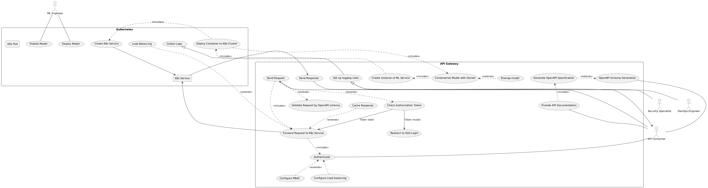
Use case diagram
https://github.com/fanglores/Advanced-Software-Design/tree/master/General/UseCases

Slide 4
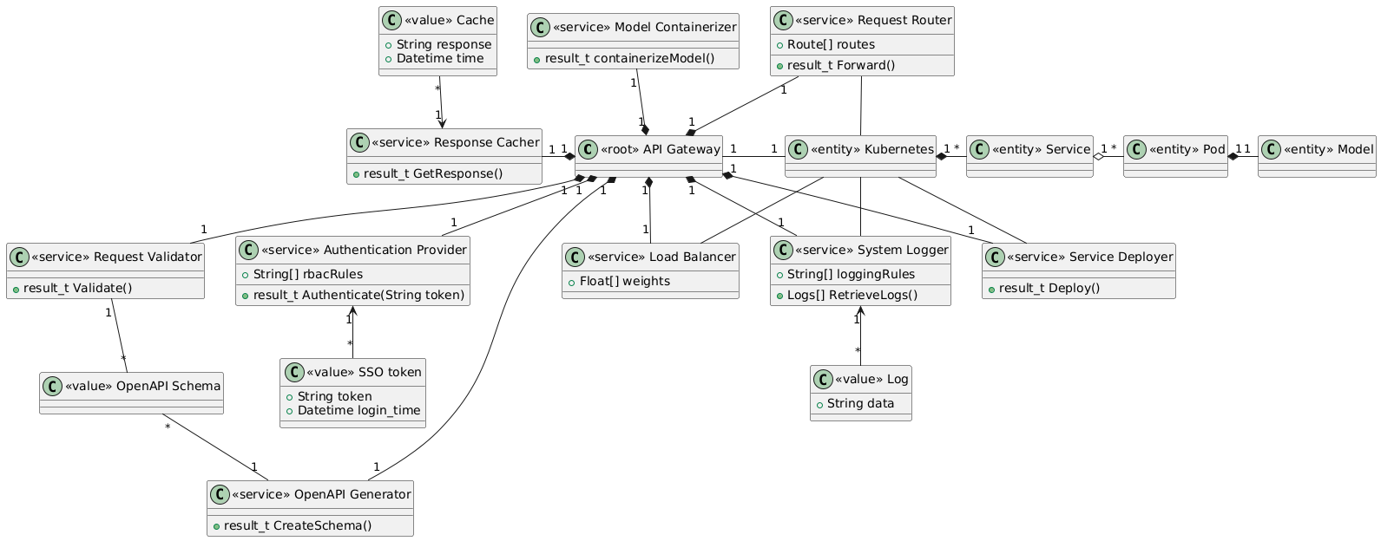
Final class diagram (monolith)

Slide 5
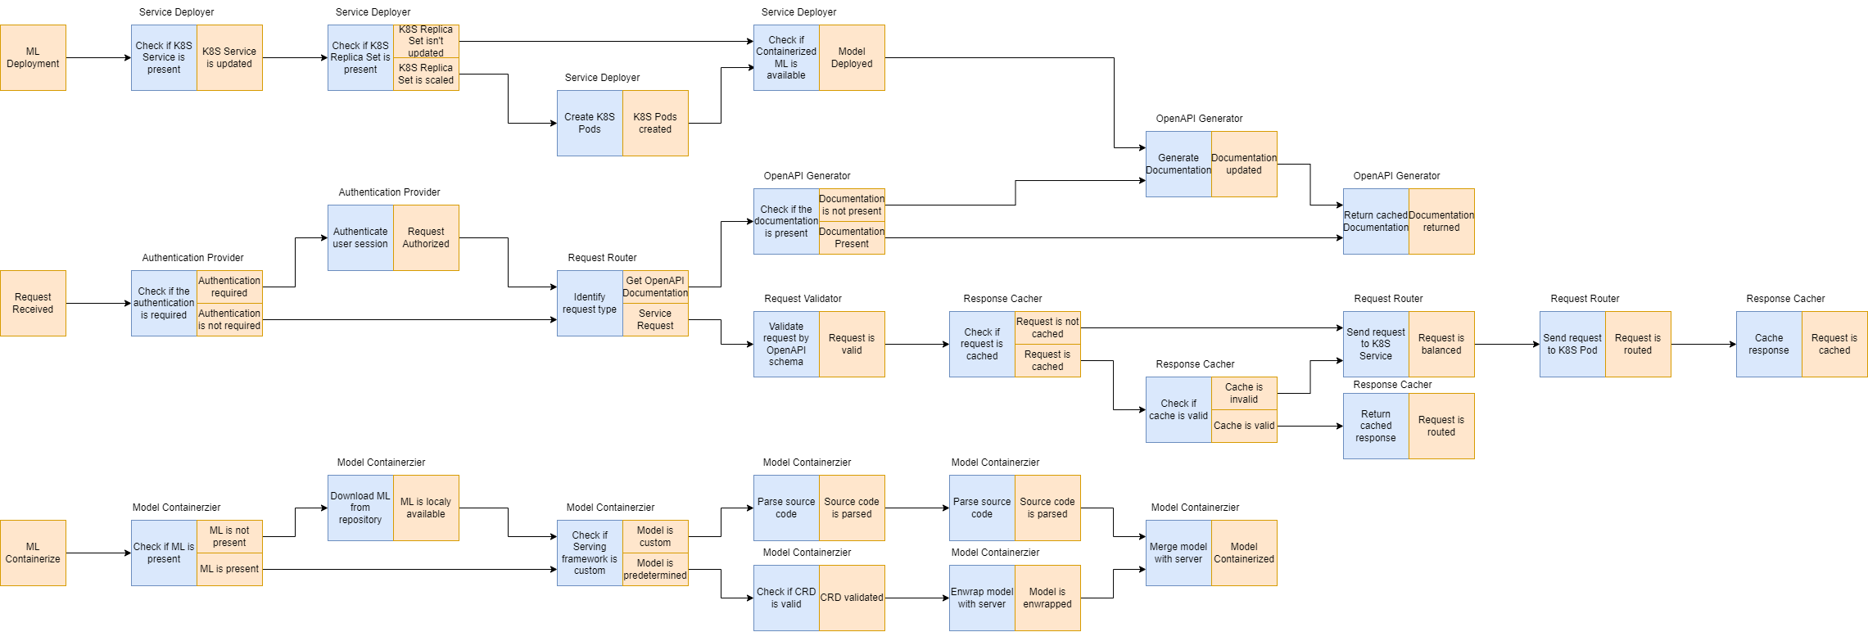
Event storming

Slide 6
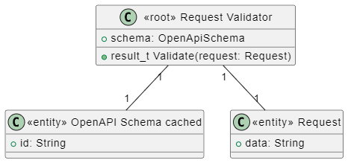
Request Validator Aggregation
stores
validates

Slide 7
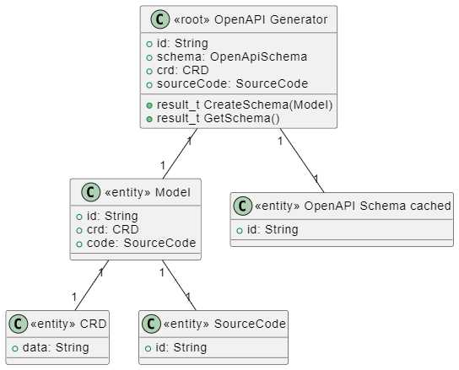
OpenAPI Generator Aggregation
receives
generates, stores
has
has

Slide 8
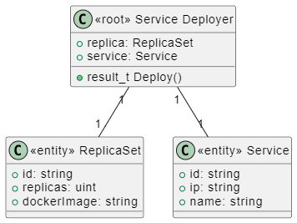
Service Deployer Aggregation
creates
manages

Slide 9
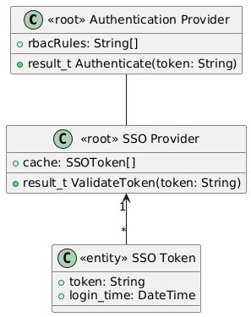
Authentication Provider Aggregation
authenticates
validates,
stores

